Slide 1
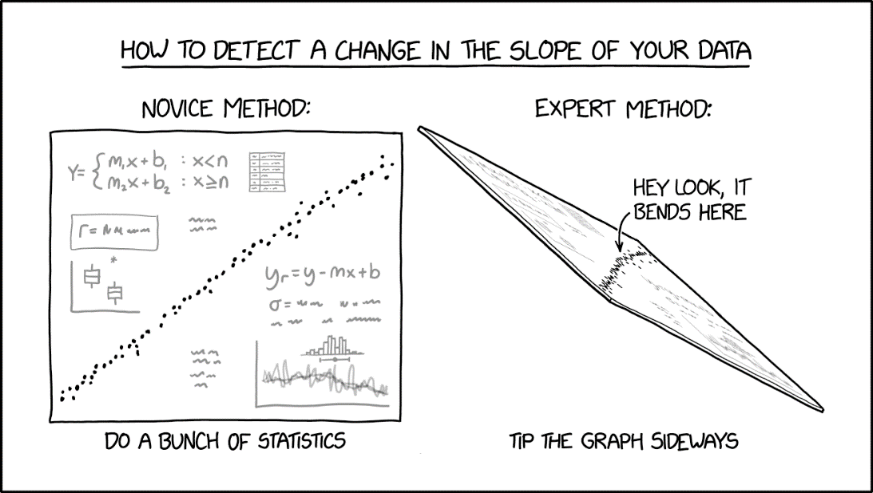
Feature space transformation methods
Gosztolya Gábor
University of Szeged
Institute of Informatics
2023 / May / 11

Slide 2
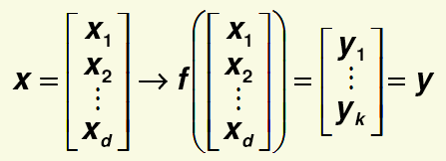
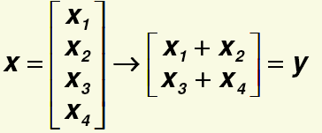
Basic idea
Instead of using the original features as they are, we will transform the features into a new feature space
Similar to how the φ() function worked for SVM: instead of the original feature vector x, we create a new feature vector y
For example:

Slide 3
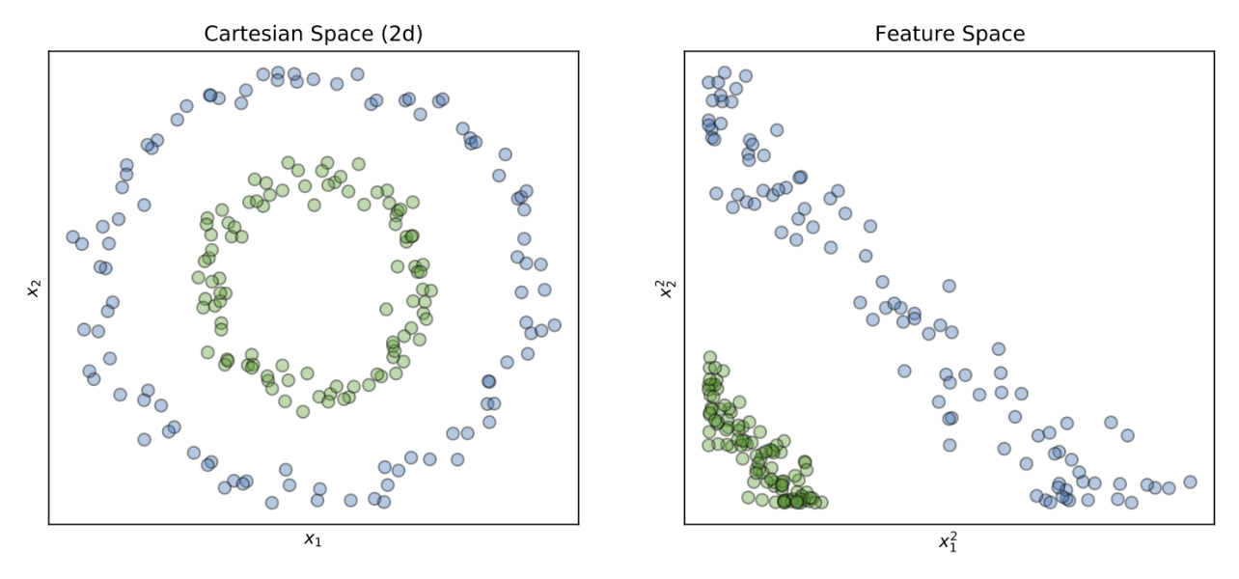
Aims
1) Reduce the number of features, i.e. k < d
It makes training faster
Helps to avoid the “curse of dimensionality”
2) Retain the important information from the original features and discard the redundancy
It hopefully helps the subsequent classification step
We will discuss only linear transformations

Slide 4
Simple transformation methods
A legegyszerűbb transzformációs módszerek az egyes jellemzőket külön-külön transzformálják
Centering (or zero-centering): from each feature, we subtract the mean of the given feature (calculated on the training samples)
This simply shifts the (mean of the) data to the origin

Slide 5
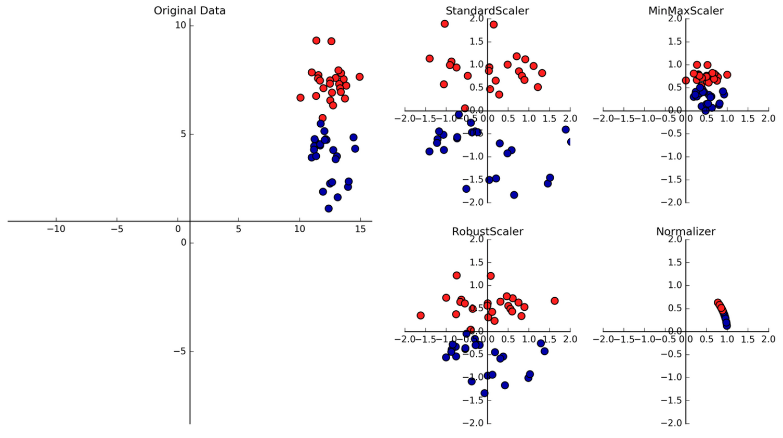
Simple transformation methods #2
Scaling: we multiply each feature with a constant
x→y = f(x)=ax
For example, “min-max scaling” guarantees that the value of x for each sample falls between some given limits
E.g. in the range [0,1]:

Slide 6
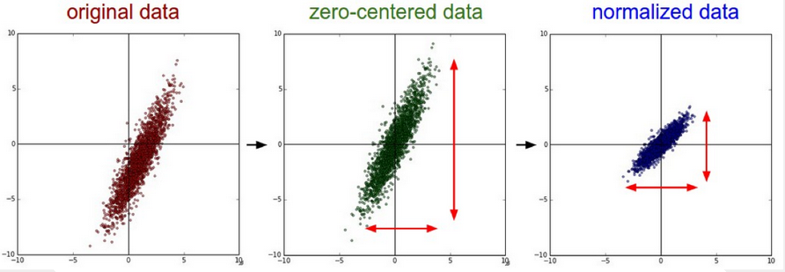
Simple transformation methods #3
Min-max scaling is very sensitive to outliers, i.e. a data sample that takes a very large or small value (perhaps only by mistake)
So it is more reliable if instead of scaling the min and max of x, we scale its variance
Centering each feature’s mean to 0 and scaling its variance to 1 is also known as data standardization (sometimes called data normalization)

Slide 7
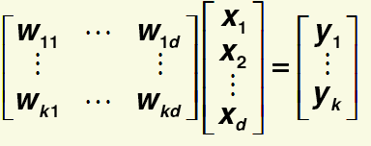
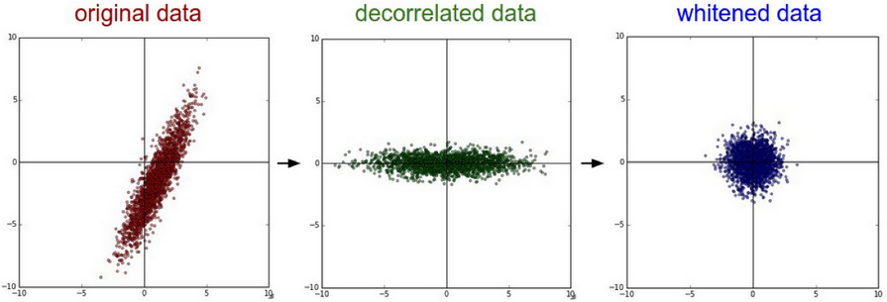
Linear feature space transformation methods
We now move on to methods that apply a general linear transformation to the features, so that the new feature vector y is obtained from x as:
Besides shifting and scaling, we can also rotate the feature space
For example, we can get decorrelated features
Whitening: decorrelation and standardization

Slide 8
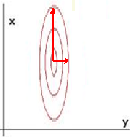
Principal Component Analysis (PCA)
Main idea: we want to reduce the number of dimensions (features)
And also minimize the information loss caused by the dimension reduction
Example: two features, and our data has a Gaussian distribution with a diagonal covariance matrix
The data has a much larger variance in x than in y (σ_{x}² is much larger than σ_{y}²)
We want to discard one of the features to reduce the no. of dimensions from 2 to 1
We keep x and discard y, as this choice results in the smaller information loss

Slide 9
Principal Component Analysis (PCA) #2
Example in 3 dimensions:
Original 3D data Best 2D Best 1D
approximation approximation

Slide 10
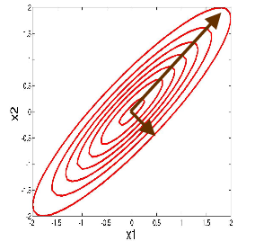
Principal Component Analysis (PCA) #3
The idea of PCA is similar, but instead of keeping or discarding features separately, it applies a linear transformation
So it is also able to rotate the data
Gaussian example: when the covariance matrix is not diagonal, PCA will create the new feature set by finding the directions with the largest variance
Although the above example is for Gaussian distributions, PCA does not require the data to have Gaussian distribution

Slide 11
Principal Component Analysis (PCA) #4
Previous example, to reduce the no. of dimensions from 2 to 1
But instead of discarding one of the features, now we look for a projection into 1D
The projection axis will be our new 1D feature y
The projection will be optimal if it preserves the direction along which the data has the largest variance
As we will see, it is equivalent to looking for the projection direction which minimizes the projection error

Slide 12
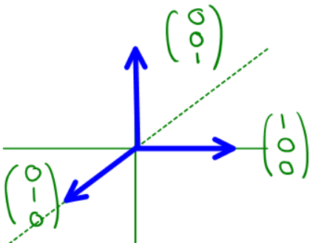
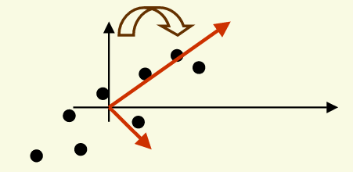
Formalizing PCA
We start with centering the data
And examine only such projection directions that go through the origin
Any d-dimensional linear space can be represented by a set of d orthonormal basis vectors
Orthonormal: orthogonal with lengths of 1
Our basis vectors are denoted by v₁, v₂, .., v_{d}
Then any x point in this space can be written as: x₁v₁+ x₂v₂ +…+x_{n}v_{n}
x : scalar, v : vector!

Slide 13
Formalizing PCA #2
PCA seeks for a new orthonormal basis (coordinate system) which as a dimension k < d
Azaz az eredeti térben egy W alteret jelöl ki
We want to find the most accurate representation of our training data D = {x₁,…,x_{n}} in some subspace W for which k < d
Let {e₁,…e_{k}} denote the (orthonormal) basic vectors of this subspace
Then any data point in this subspace can be represented as

Slide 14
Formalizing PCA #3
However, the original data points are in a higher dimensional space (remember that k < d), so they cannot be represented in this subspace
Still, we are looking for the representation that has the smallest error (“minimal reconstruction error”)
E.g. for data point x₁ :

Slide 15
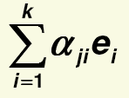
Formalizing PCA #4
Furthermore, we want to calculate (and minimize) the representation error in the new space over all the training samples
The representation of any training sample x₁ can be written as
Total error can be written as:
We have to minimize J
Also we have to take care that the resulting e₁,…e_{k} vectors have to be orthonormal

Slide 16
Formalizing PCA #5
Minimizing J can be solved by setting the derivative to zero, and using Lagrange multipliers to satisfy the constraints
For the derivation see: http://www.csd.uwo.ca/~olga/Courses/CS434a_541a/Lecture7.pdf
After a long derivation, J reduces to:
…where
Minimizing J is equivalent to maximizing
Apart from a constant multiplier, S is equivalent to the covariance matrix of the data (μ is 0, as we centered our data!)
Constant!

Slide 17
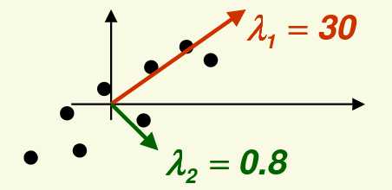
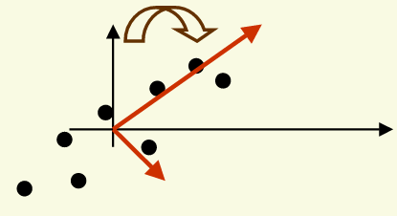
Formalizing PCA #6
The result (the new e₁,…,e_{k} base vectors) are those eigenvectors of S which have the largest corresponding λ₁,… ,λ_{k} eigenvalues
The larger the given λ_{i} eigenvalue is, the larger is the variance in the corresponding direction
So the solution is what we intuitively expected
PCA projects the data into a subspace of dimension k along the directions for which the data shows the largest variance
So PCA can indeed be interpreted as finding a new orthogonal basis by rotating the coordinate system until the directions of maximum variance are found

Slide 18
How PCA approximates the data?
Let e₁,…,e_{k} be the eigenvectors of S, sorted in decreasing order according to the corresponding eigenvalues
In the original space, any point x can be written as:
In the transformed space, we keep only the first k components, and discard the remaining ones – so we obtain only an approximation of x

Slide 19
The principal components in PCA
The α_{j} components will be the principal components of x
The larger the value of k is, the better the approximation is
The components are arranged in the order of importance, the more important components come first
PCA keeps the k most important principal components of x as the approximation of x

Slide 20
Transforming the data
How to transform the data into the new coordinate system?
Let’s define the linear transformation matrix as E = [ e₁,…,e_{k} ]
Then each data item x can be transformed as y = Ex
So instead of the original d-dimensional feature vector x, we can now use the k-dimensional transformed feature vector y
This step can be performed before any classification or regression technique as a data pre-processing step

Slide 21
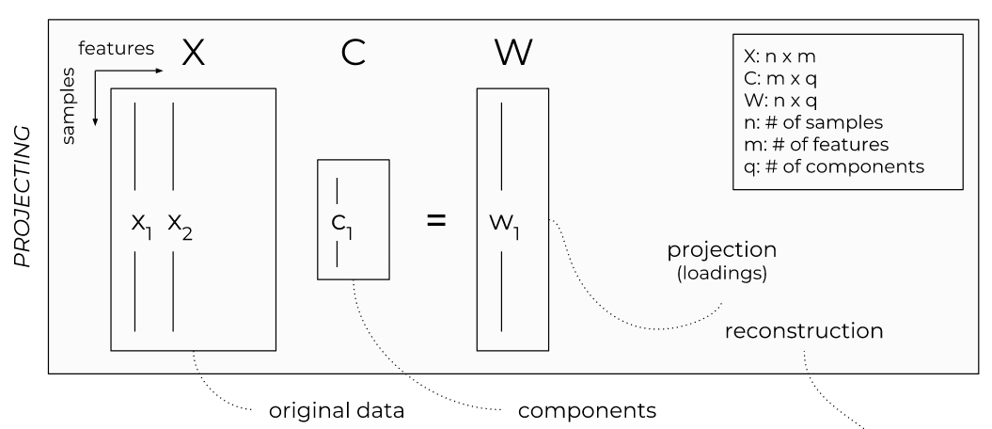
Transforming the data #2
Matrix multiplication!
Size of D : d x n
Size of a data sample: d x 1
Size of E (originally) : d x d
Size of E (after keeping only the principal components) : k x d
Size of Ex: k x 1

Slide 22
PCA – Summary

Slide 23
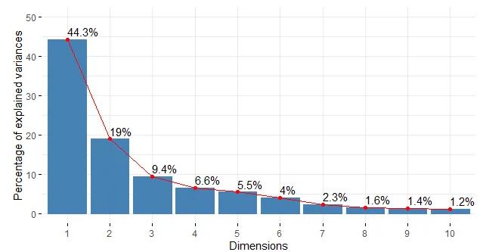
Determining the number of dimensions #1
We transform a d-dimensional feature space to a k-dimensional one (k < d)
How to determine k?
Idea: besides the eigenvectors, we also obtain the eigenvalues
We already use these to sort the eigenvectors (in descending order)
These are typically treated as the values which measure the amount of information (data variance)

Slide 24
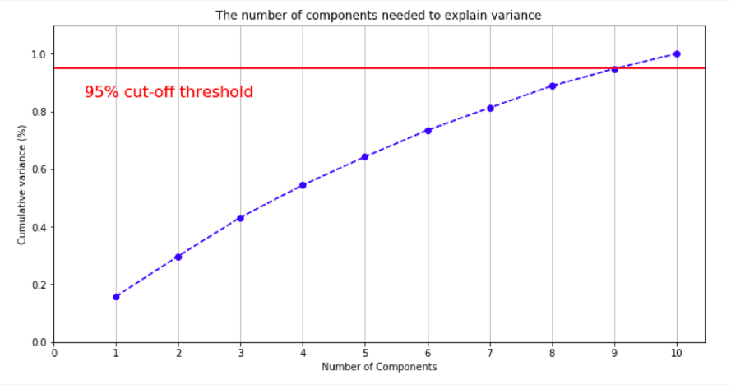
Determining the number of dimensions #2
Solution: we retain as much eigenvalues (and eigenvectors) which represent a given percentage of the original information (data variance)
The sum of the first k eigenvalues should be the “sufficiently large” percentage of the sum of all the eigenvalues
Typical values: 95%, 99%
Discarding the “unnecessary” components is practically to reduce the original matrix (with the size of d x d) to the right size (k x d)
In practice, before PCA we use standardization

Slide 25
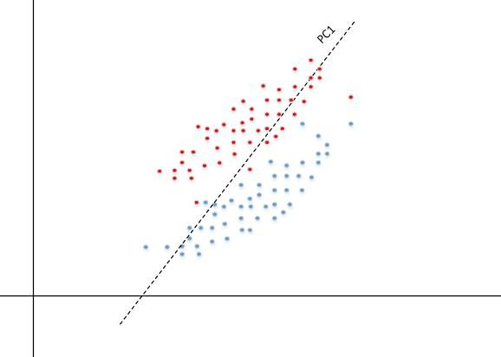
Motivation of linear discriminant analysis (LDA)
PCA retains the directions where the variance of data is maximal
However, it ignores the class labels
The directions with the maximal variance might be useless for separating the classes; for example:

Slide 26
Linear discriminant analysis (LDA)
Linear discriminant analysis seeks to project the data in directions which are useful for separating the classes
PCA is an unsupervised feature space transformation method (no class label required)
LDA is a supervised feature space transformation method (takes the class labels into consideration)
LDA for the 2-class case is also known as Fisher’s linear discriminant

Slide 27
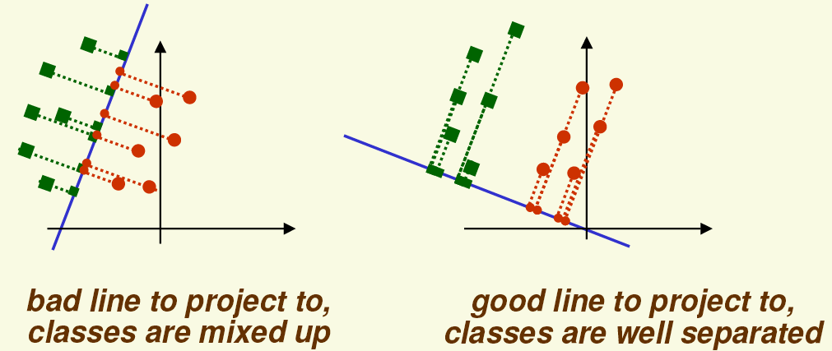
LDA – Main idea
We seek projection directions along which the samples can be well separated
Example (2 features, 2 classes):
How to measure the separation between the projections of classes?
Try to use the distance between the μ₁ and μ₂ means of the projection of the classes, i.e.

Slide 28
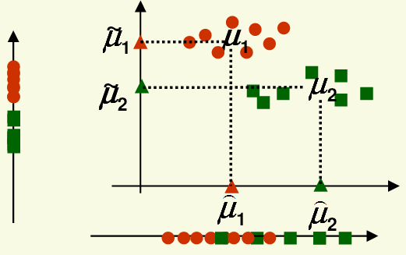
LDA – example
How good is as the measure of class separation?
In the above example, projection to the vertical axis separates the classes better than the projection to the horizontal axis
Yet is larger for the latter!
The problem is that we should also take the variances into consideration!
Both classes have a larger variance along the horizontal axis than along the vertical axis

Slide 29
LDA – Formalization for two classes
We look for a projection direction that maximizes the distance of the class means and minimizes class variances at the same time
Let y_{i} denote the projected samples
Let’s define the scatter of the two projected classes as
(scatter is the same as variance, within a constant multiplier)
Fisher’s linear discriminant seeks a projection direction v which maximizes J(v) :

Slide 30
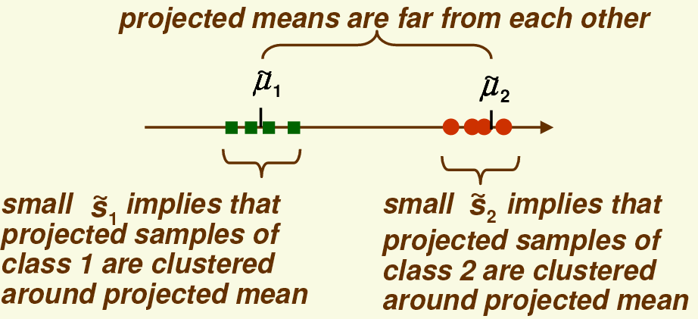
LDA – Interpretation
A large J(v) value means that:
To solve the maximization, we have to express J(v) explicitly, then simplify it and calculate its derivative…

Slide 31
LDA – Interpretation
A large J(v) value means that:
To solve the maximization, we have to express J(v) explicitly, then simplify it and calculate its derivative…

Slide 32
LDA – Derivation
The scatter matrix of the two classes before projection:
The “within class” scatter matrix:
The “between class” scatter matrix:
It measures the separation between the means of the two classes (before projection)
It can be shown that:
And:

Slide 33
LDA – Derivation #2
Using the above notation, we obtain
We can maximize it by taking the derivative and setting it to zero
Similarly to the PCA case, it leads to an eigenvalue problem with the solution
This is the optimal direction when we have two classes
The derivation can be extended to multiple classes as well
In the case of c classes we obtain c-1 directions
And instead of a single v projection vector, we get a V projection matrix
The x_{i} data samples can be projected by the y_{i} = V^{t}x_{i} linear transformation

Slide 34
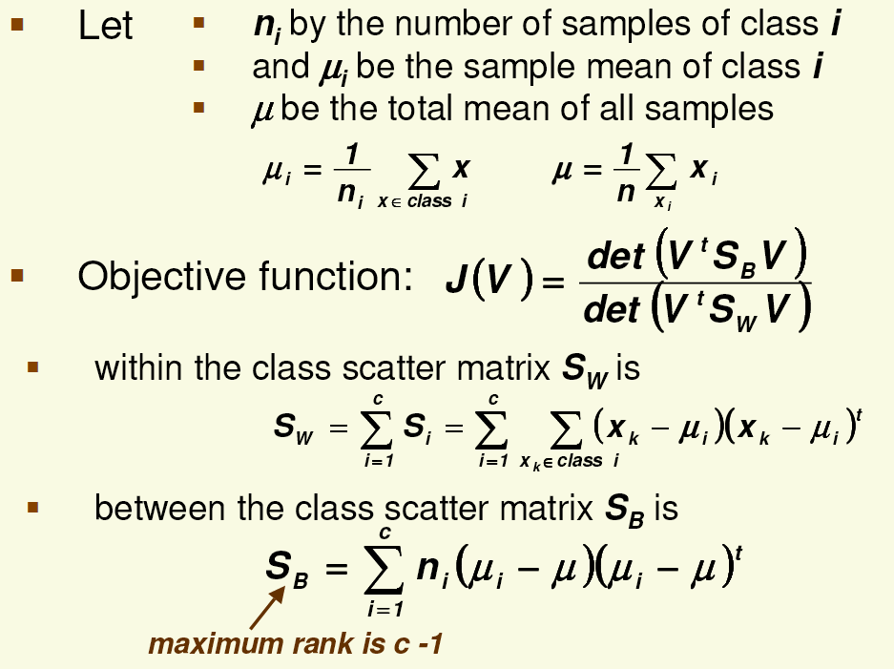
LDA – Multi-class case
class-wise mean vectors
mean vector for all the examples
target function to be maximized

Slide 35
LDA – Multi-class case #2
Solving the maximization again requires eigenvalue decomposition
The decomposition results in the v₁, ..,v_{c-1} eigenvectors
The optimal projection matrix into a subspace of k dimensions is given by the k eigenvectors that correspond to the largest k eigenvalues
As the rank of S_{b} is (at most) c-1, LDA cannot produce more than c-1 directions, so the number of the projected features obtained by LDA is limited to c-1
As a comparison, the new feature space obtained by PCA has at most d dimensions, where d is the size of the original feature space

Slide 36
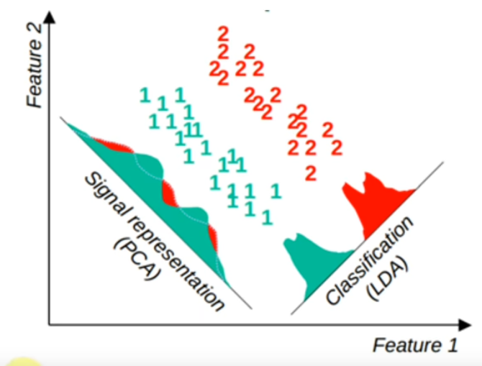
PCA vs LDA
PCA
Linear transformation
Unsupervised method
Looks for directions where the data has the largest variance
The size of the new feature space is at most the size of the original feature space
LDA
Linear transformation
Supervised method
Looks for directions where the samples can be well separated
The size of the new feature space is at most the number of classes minus one

